Slide 1
MINDS

Slide 2
Comparison air & water quality
Healthy, clean drinking water is a matter of course for us.
What expectations do we have of the air, that our children breathe in school & kindergarten?
Notes:
Inviting us to reflect – what is important to us regarding the health of our children and what values have become important to us over the last few years? What was it like 3, 5 years ago? Learning to learn: what do our children need to learn well?

Slide 3
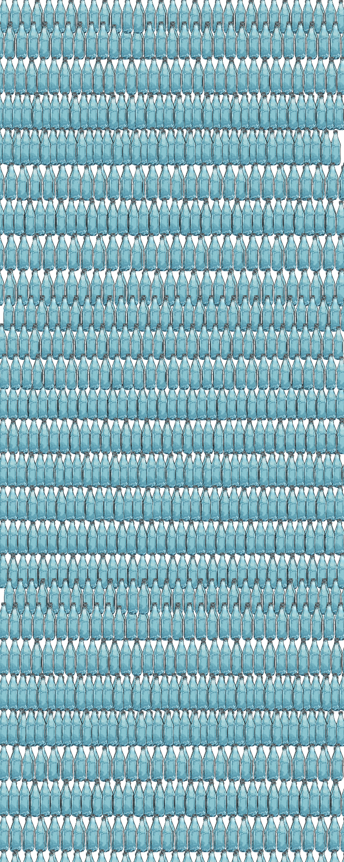
Daily amount of air & water in litres
Water: 1-2 litres
Air: >11.000 litres
Water is Controlled & Processed.
What about our air?
Notes:
How much air do you inhale every day? Adults take 23,000 breaths a day, children almost twice as many That's 8-10 liters of air per minute

Slide 4
What are our values for school life?
Learning success
Attendance Rate
Health
Social participation
Equity
Performance
What else?
Notes:
Inviting to reflect – what is important to us regarding the health of our children and what values have become important to us over the last few years? Or why have we always accepted that school and kindergarten go hand in hand with infection & illness?

Slide 5
Healthy indoor air safeguards our values!
Learning success
Attendance Rate
Social participation
Health
Equity
Performance
… and more
https://www.igoe.at/saubere-luft-und-wissenschaft/
Notes:
Studies clearly show the effect of air changes (recommendations from WHO & CDC)

Slide 6
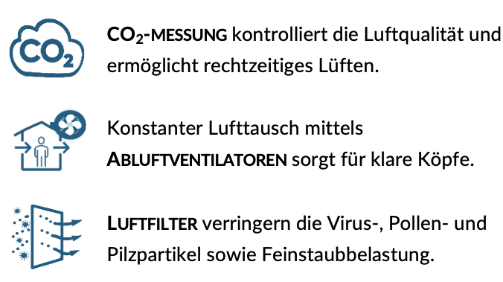
Ways to improve indoor air quality:
Recommendation: 6 air changes per hour or Per person 35m³/hour
CO₂ MEASUREMENT controls air quality & enables timely ventilation.
Constant air exchange using HVAC or
EXHAUST FANS ensures clear minds.
AIR FILTERS reduce virus, pollen & fungal particles as well as fine dust pollution.
Air treatment and exchange depending on conditions
Notes:
Größerer erechneter Wert ist der wichtige!
6-facher Luftwechsel pro Stunde bzw. 35m³/Stunde

Slide 7
As Indoor Air Quality Indicator
Air - Outdoor: 0.042% CO2 (=420ppm) Exhaled air contains 3-4% CO2 (=30.0000-40,000 ppm) CO₂ values serve as an indicator of breathed air AND indoor air quality
Quelle: https://elpais.com/especiales/coronavirus-covid-19/how-to-avoid-the-infection-in-indoor-spaces/
Notes:
ppm = parts per Million (Teilchen pro einer Million Luftteilchen)

Slide 8
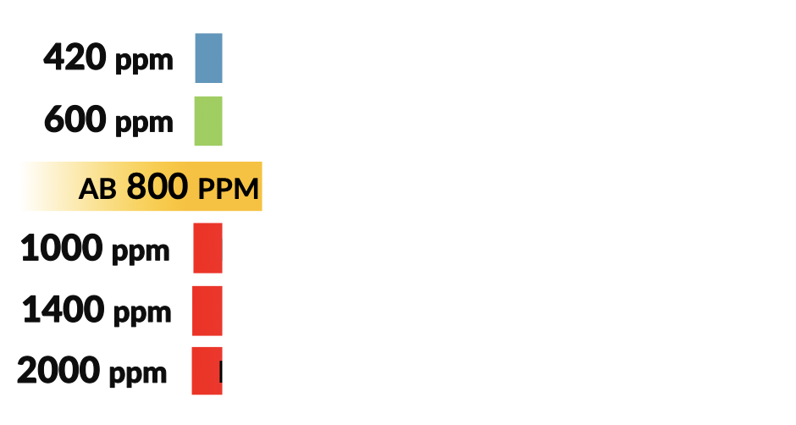
What is the indoor air like here? How tired are you? Is to open a window an option?
Healthy outdoor air
Healthy indoor climate
Fresh air is necessary
Performance drops by 15%
WHO limit value for healthy air
Performance drops by 50%
Headaches & fatigue
Notes:
What values are we striving for? Cognitive performance decreases from 1000ppm s Note – how are you sitting right now? Energy-efficient houses should have ventilation with heat recovery, so ventilation is not necessary (measurement with sensor recommended). What about thermally renovated houses, schools and kindergartens: the building envelope has been sealed, but for cost reasons no

Slide 9
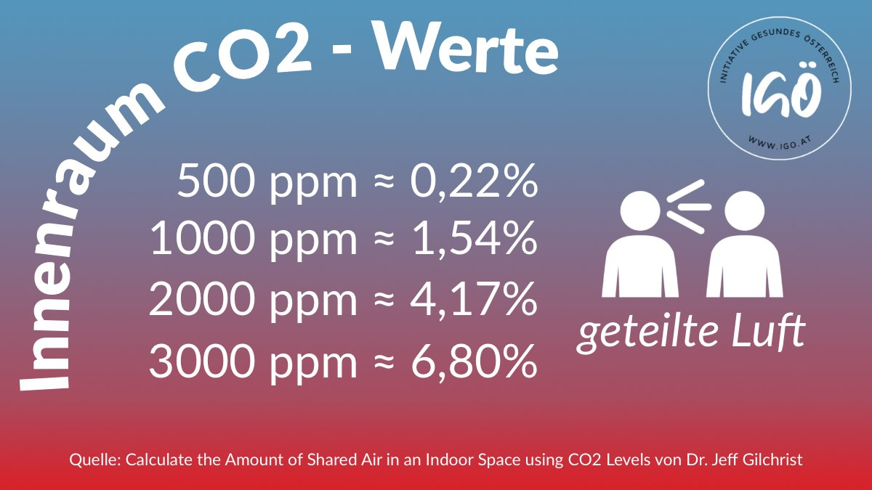
each 65th breath of rebreathed air
each 25th breath of rebreathed air
each 15th breath of rebreathed air
If we don't drink water that others spat out,
why do we breathe air that others exhaled?
Notes:
Aerosols – accumulation by airborne particles that can be loaded with viruses. Transmissions over many meters and long after a person was in the room

Slide 10
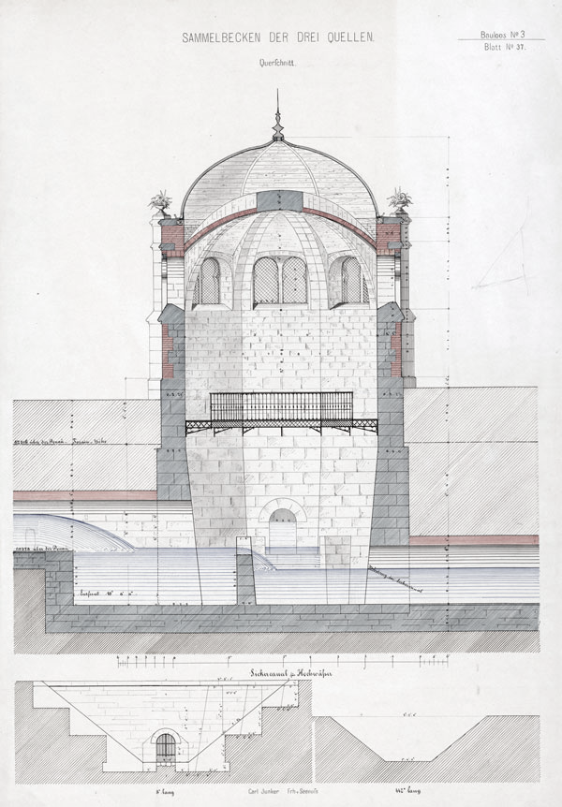
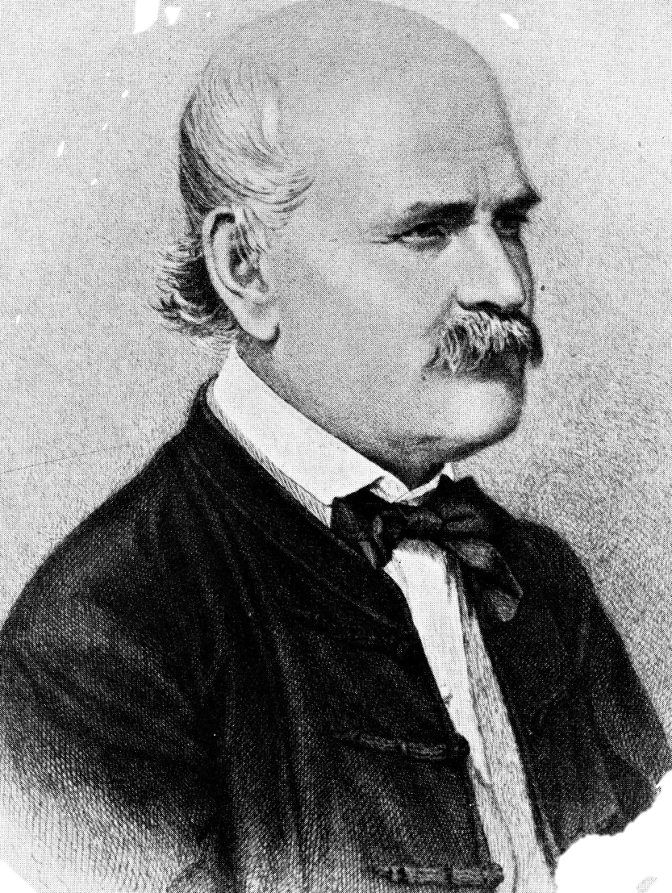
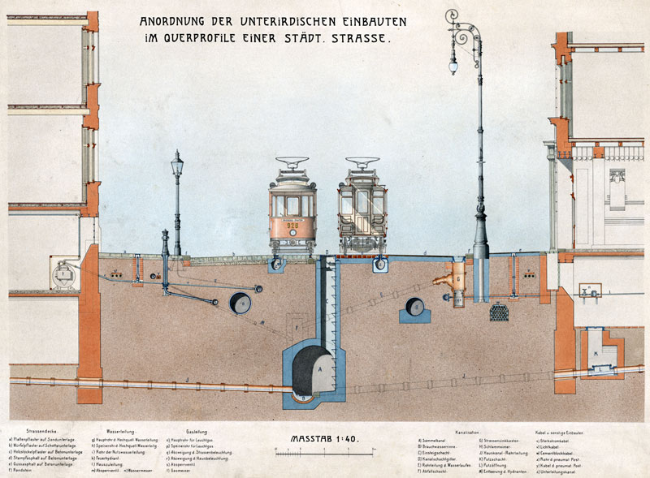
Clever handling of pathogens
Knowledge of infections through aerosols:
Healthy indoor air
Cholera, plague & puerperal fever:
Drinking water treatment
Sewerage
Hand hygiene & Disinfection
Infection over long distances & possible in case of subsequent use of rooms
Dr. Ignaz Semmelweis
Notes:
Learning to live with cholera meant no longer pouring excrement on the streets, building sewage systems, filtering drinking water. With Corona, we are still figuratively pouring excrement on the street and drinking unfiltered water.https://zdfheute-stories-scroll.zdf.de/aerosole-klassenzimmer-corona/
https://www.geschichtewiki.wien.gv.at/images/4/42/Straßenquerprofil.jpg
https://www.geschichtewiki.wien.gv.at/index.php?title=Datei:Wasserversorgung.jpg&filetimestamp=20230914123930&
Aerosols: Transmissions over many meters and long after a person has been in the room Particles smaller than 10 μm can remain in the air for hours to days. Aerosols are generally not stable and usually change over time depending on humidity, temperature and other physical and chemical processes. Aerosols can also contain bacteria and viruses.

Slide 11
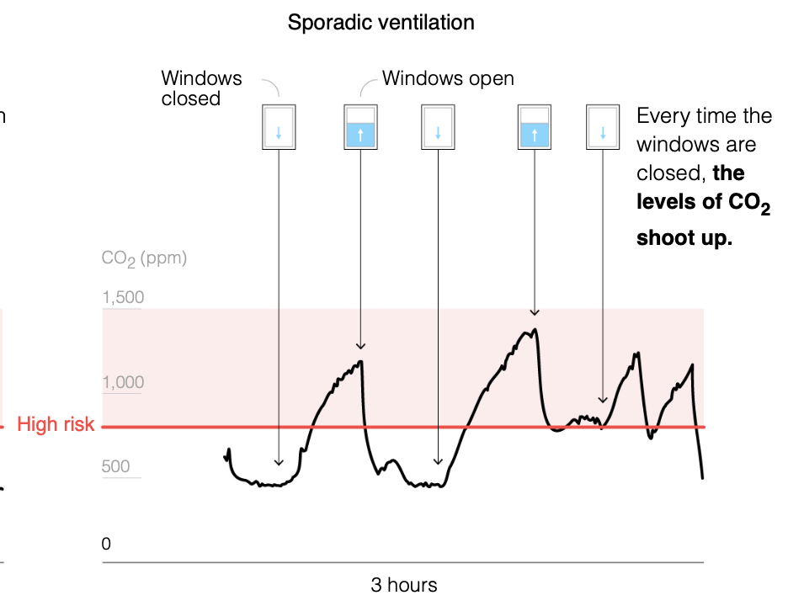
Result sporadic ventilation – not sufficient!
CO2 measurement
shows problem:
Sporadic ventilation ist not sufficient in eucational centers!
https://elpais.com/especiales/coronavirus-covid-19/how-to-avoid-the-infection-in-indoor-spaces/

Slide 12
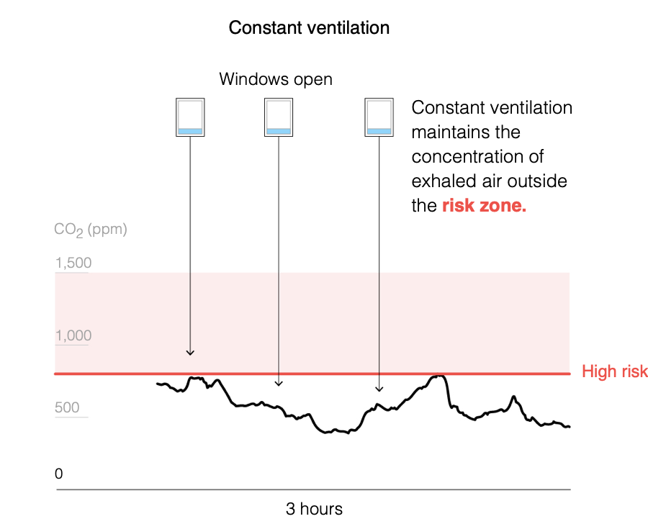
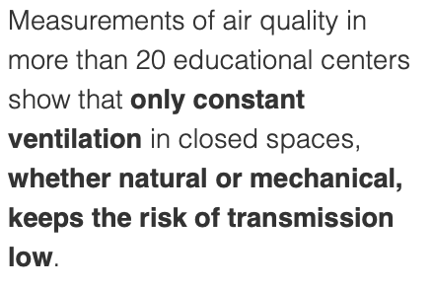
Constant ventilation: astonishingly sustainable
Tilt ventilation:
energy efficient & available in classes
Risiko
https://elpais.com/especiales/coronavirus-covid-19/how-to-avoid-the-infection-in-indoor-spaces/
Notes:
Important: Close windows when no one is in the room. Pupils warm the room, continuous ventilation is more comfortable and measurably more energy-efficient!

Slide 13
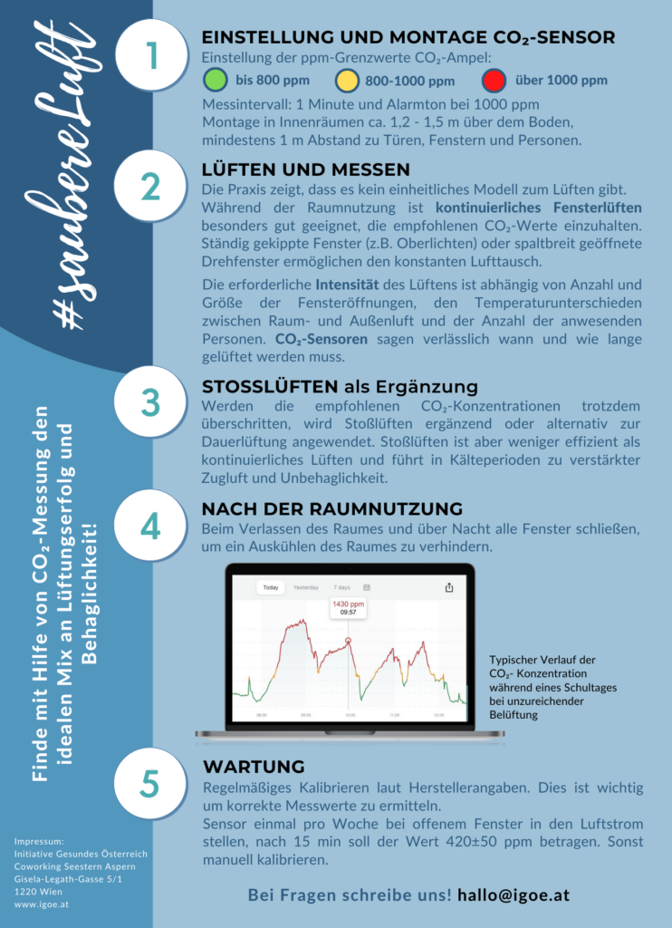
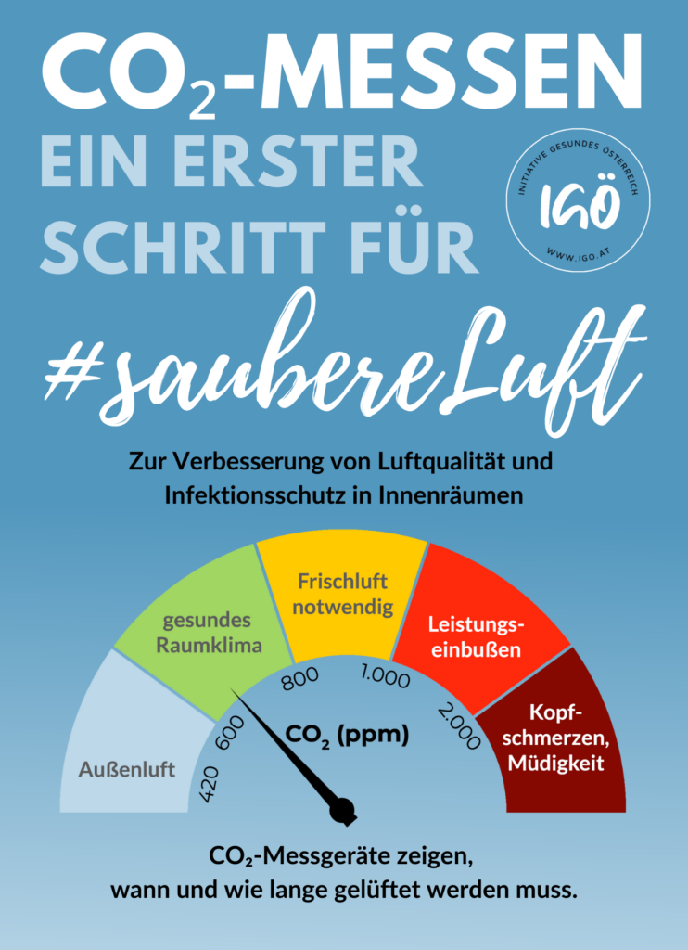
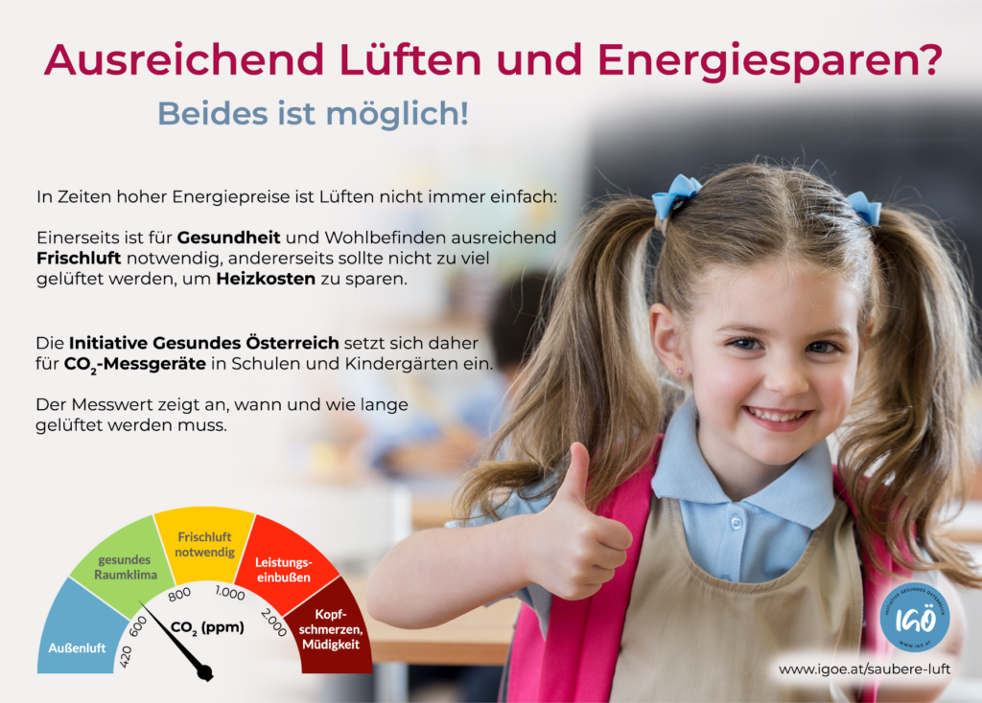
More information to sustainable ventilation
https://www.igoe.at/saubere-luft-folder/

Slide 14
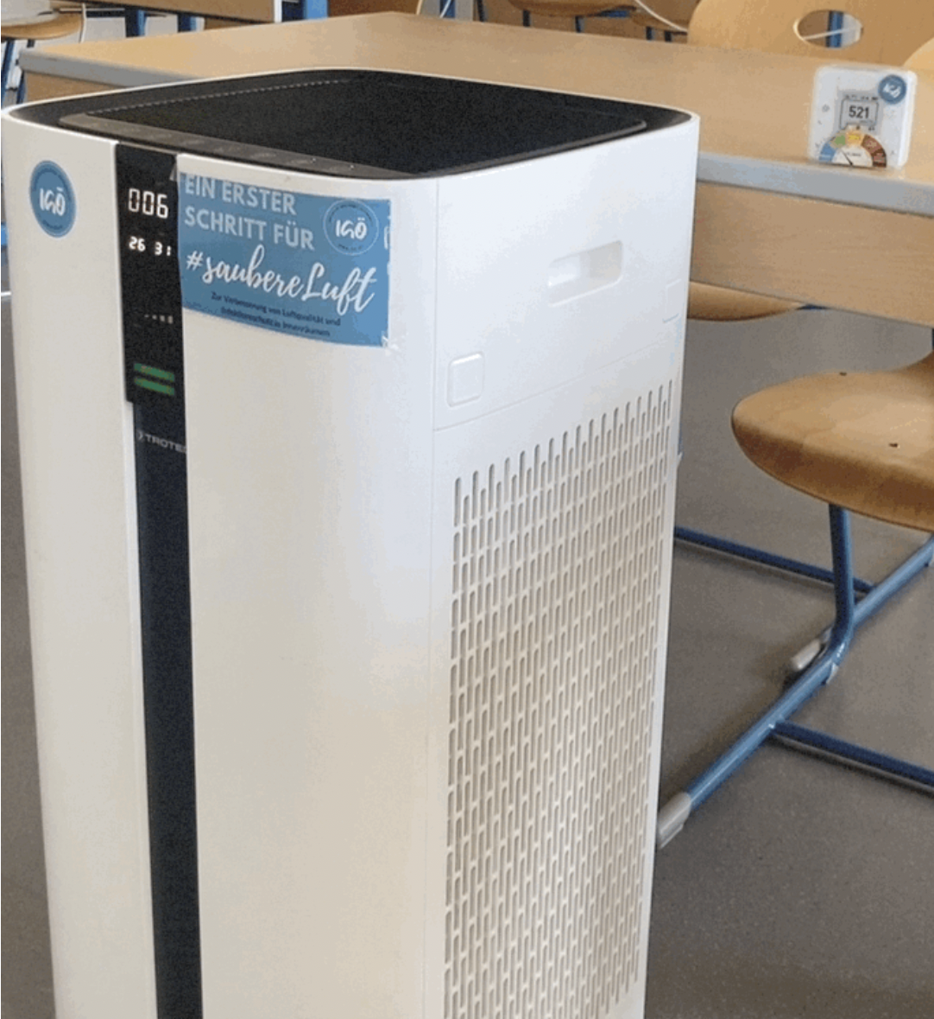
HEPA Purifiers: another "layer of protection"
HEPA-Purifiers
Filters pollen, virus and fungal particles & particulate matter pollution from the air.
Supportes ventilation e.g. less air exchange takes place
(weather-related or similar)
https://elpais.com/especiales/coronavirus-covid-19/how-to-avoid-the-infection-in-indoor-spaces/

Slide 15
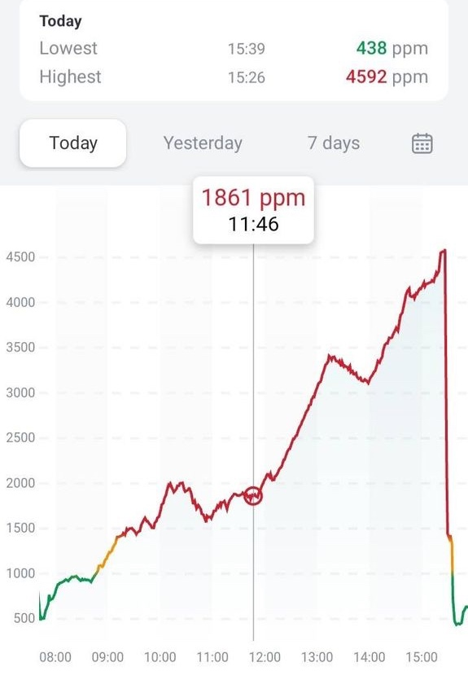
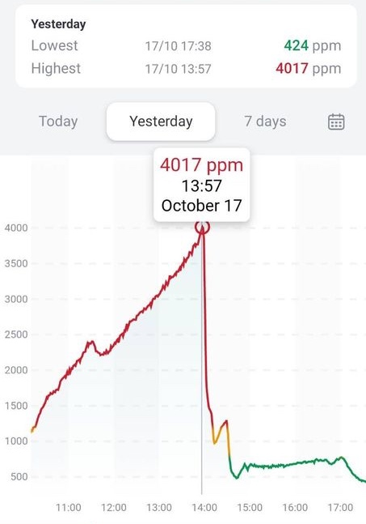
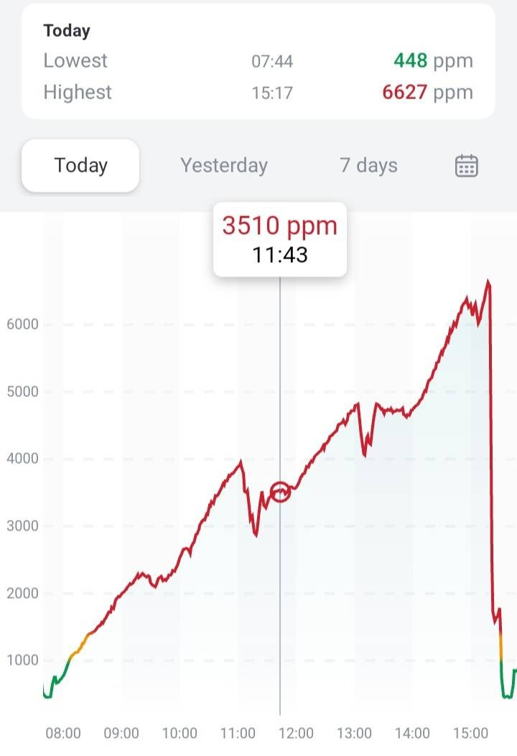
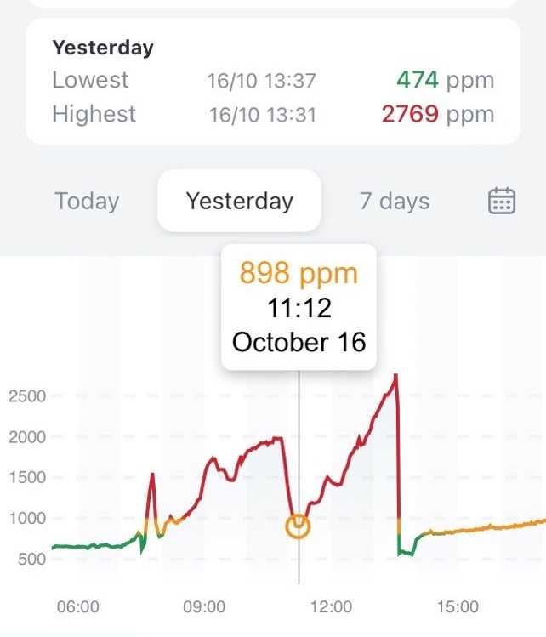
Austrian School Reality October & November 2023

Slide 16
Effects of good and healthy indoor air
More well-being and health Fewer substitute hours for educators Less loss of education, more social participation Less childcare effort in the families Less absent students and teachers More concentration and performance Efficient ventilation & HEPA purifiers: energy cost reduction
Notes:
Welche Effekte hat der Fokus auf Innenraumluft zu legen?

Slide 17
What do we want for our children?
What air exchange rate do you want for our children?
At which CO₂ values should our children learn & be creative?
Notes:
Inviting us to reflect – what is important to us regarding the health of our children and what values have become important to us over the last few years? What was it like 3, 5 years ago? Learning to learn: what do I need to learn well?

